Slide 1


Unsupervised Clustering
Tom Zimmerman
IBM Research-Almaden
Center for Cellular Construction
Oct 16,2020
This material is based upon work supported by the NSF under Grant No. DBI-1548297.
Disclaimer: Any opinions, findings and conclusions or recommendations expressed in this material are those of the authors and do not necessarily reflect the views of the National Science Foundation.

Slide 2
CSC698 Monday Oct 5, 2020
Unsupervised Clustering Lecture (50 min)
Theory
Library, methods and functions to apply theory
Break (10 min)
Q&A (15 min) Unsupervised Clustering student-driven deep dive
Wed Homework
Python Skills: Write one code example using a previous function
emphasis on data slicing, loops, program control
Add news functions to cheat sheets

Slide 3
☹ Prof Z No Office Hours Tomorrow Tuesday (Tues 10/13/20) ☹
CSC698 Wednesday Oct 7, 2020
Mini-Assignment (12:30-12:40 pm)
Unsupervised Clustering Lecture (12:40-1 pm)
Theory
Library, methods and functions to apply theory
Python Review: Loops and Conditions (1-1:15 pm)
Breakout Room (1:15 to 1:30 pm)
Python Skills: Demonstrate one code example using a previous function
Review Python and library functions to cheat sheets
Group Discussion (1:30 to 1:45 pm)
Review code examples
Cheat sheet highlights (e.g. Amisha cap = cv2.VideoCapture(0))

Slide 4
☹ Prof Z No Office Hours Tomorrow Tuesday (Tues 10/13/20) ☹
CSC698 Monday Oct 12, 2020
Grid of Images (45 min) Live demo of designing and writing a function
Break (10 min)
Q&A (20 min) ViewFeaturesVideo_3.py student-driven deep dive
Wed Homework
Python Skills: Write one program that includes a call to a function you wrote and uses at least three of these numpy functions:
reshaping, stack, delete, where
Add new functions to cheat sheets
Be prepared to run your program and share your cheat sheet with the class

Slide 5
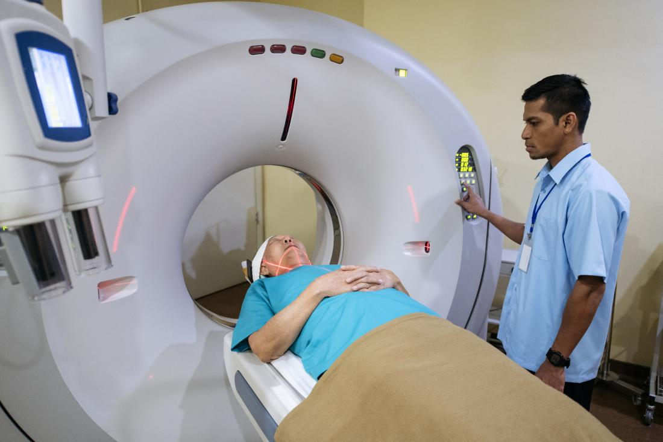
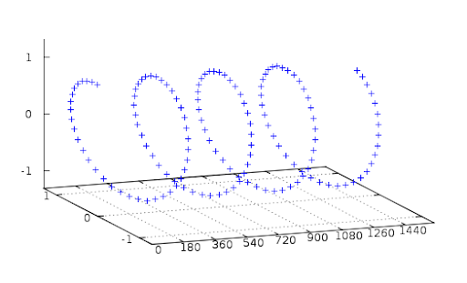
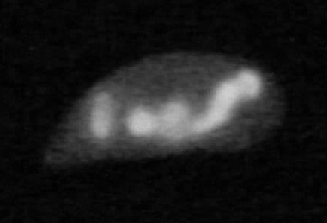
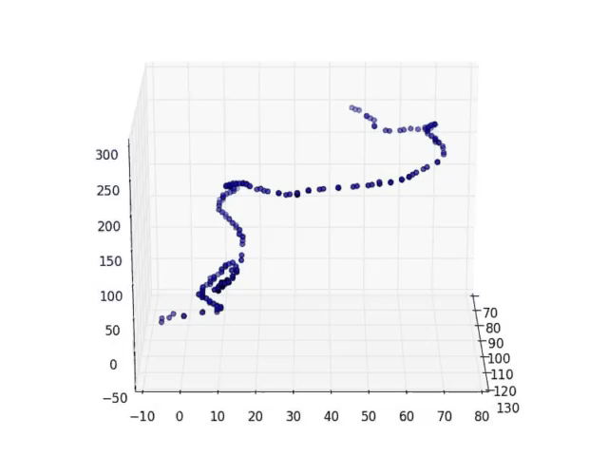
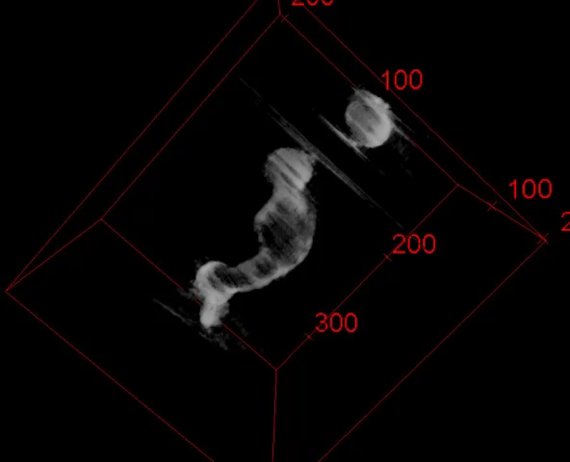
“Generating Three Dimensional Models of Microscopic Subject from a Sequence of Images”
US Patent 10,810,759 Issued Oct 20, 2020
from skimage.transform import radon
sinogram = radon(image, theta=theta, circle=True)
Computerized Axial Tomography
Center of Mass of Each Slice from
Final Reconstructed 3D Model
Final Reconstructed 3D Model

Slide 6
CSC698 Wednesday Oct 14, 2020
Finish Grid program as function call (20 min, 12:30 to 12:50 pm)
Review Homework #9 Assignment (10 min, 12:50 to 1:00 pm)
Mini-Assignment Breakout Rooms (20 min, 1:00 to 1:20 pm)
Python Skills Code Demo
Review Cheat Sheets
Group Discussion (25 min, 1:20 to 1:45 pm)
Python Skills Code Demo
Review Cheat Sheets

Slide 7
Homework #8 Assignment Assigned: Wednesday 7 Oct 2020 Due: Tuesday 13 October 2020 11:59 PM ASSIGNMENTS 1. Conditional and Loop Skills Watch this “Conditionals and Loops in Python” tutorial video: https://youtu.be/qRP_yxmnddA Write ONE Python program that demonstrates you understanding of all of the following concepts (a) three levels of nested loops (b) create a list and use the list to reiterate the loop
(c) use ‘range” function to create the loop list (d) create ‘while’ loop that combines conditionals
(e) create a list decisions using the following sequence ‘if, elif,elif,else’ Make sure you comment each section of your code, pointing out where you are demonstrating each of the concepts in your code. DELIVERABLE: Upload your ONE program that demonstrates all 5 (a to e) concepts (e.g. conditionLoopDemo.py)
2. Bouncing Rectangle
Modify the “movingRectangle_1.py” code so the rectangle is green and bounces horizontally across the screen four times then stops the program (i.e. moves right until it hits the maximum x, them moves left until it hits the minimum x, repeats four times then quits program).
DELIVERABLE: Upload your ONE program that demonstrates the bouncing green rectangle (e.g. bounce.py)
3. Unsupervised Classification
Watch video about k-means clustering ://youtu.be/7Qv0cmJ6FsItps://youtu.be/_aWzGGNrcic
Use ViewFeaturesVideo_2.py to view and save a 3D scatter plot of your clustered objects.
Modify Cluster_5.py to create an “Elbow Plot” of the inertia, plot inertia (y-axis) vs number of clusters (x-axis) and identify the best number of clusters.
DELIVERABLE:
(a) Upload the *.png image of your 3D scatter plot of your clustered objects
(b) Upload the Python code you wrote to generate your “Elbow Plot” data (e.g. elbow.py).
(c) Upload your “Elbow Plot” as a *.png or *.jpg image. You can use pyplot to make the plot in Python (preferred) or Excel.
(d) Upload a text file (*.txt) that indicates the best number of clusters for your data and the inertia with that number of clusters.

Slide 8
Homework #9 Assignment Assigned: Wednesday 14 Oct 2020 Due: Tuesday 20 October 2020 11:59 PM 1. Defining Your Own Python Function Read this post on “Defining Your Own Python Function”
https://realpython.com/defining-your-own-python-function/
(A) Write up three things you learned from reading the post and submit document as a pdf.
(B) Write TWO Python programs, as follows:
PROGRAM 1: A function that takes three arguments and returns three arguments
PROGRAM 2: A main program that calls the function in Program 1. In the main program, call the function two different ways; (a) using positional arguments and (b) using keyword arguments.
DELIVERABLES: (a) Upload your “what you learned” pdf document. (b) Upload your TWO programs that demonstrates a call to a function using positional and keyword arguments.
2. Viewing Clustering Results
Finish debugging the grid_2.py program and call the doGrid function from the ViewFeaturesVideo_2.py program to create and save one grid image per cluster. Each grid image should contain the first 200 members of a cluster. There are 5 clusters so you should produce 5 grid images, one per cluster. Each image is 1920 x 1080 and contains 200 images of the objects in the cluster. You can reduce the number of members if you feel it would look better.
DELIVERABLES: Upload FIVE png images. Each 1920x1080 color image contains a grid of up to 200 region-of-interest images from a cluster. Label them cluster0.png, ..., cluster4.png

Slide 9
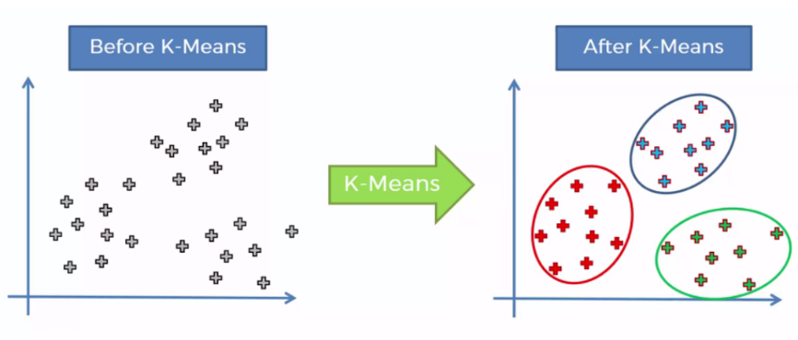
Feature Y
Feature Y
Feature X
Feature X
Unsupervised machine learning dividing data into distinct groups with similar feature values.
K refers to how many groups (clusters) to create.
https://towardsdatascience.com/k-means-clustering-identifying-f-r-i-e-n-d-s-in-the-world-of-strangers-695537505d

Slide 10
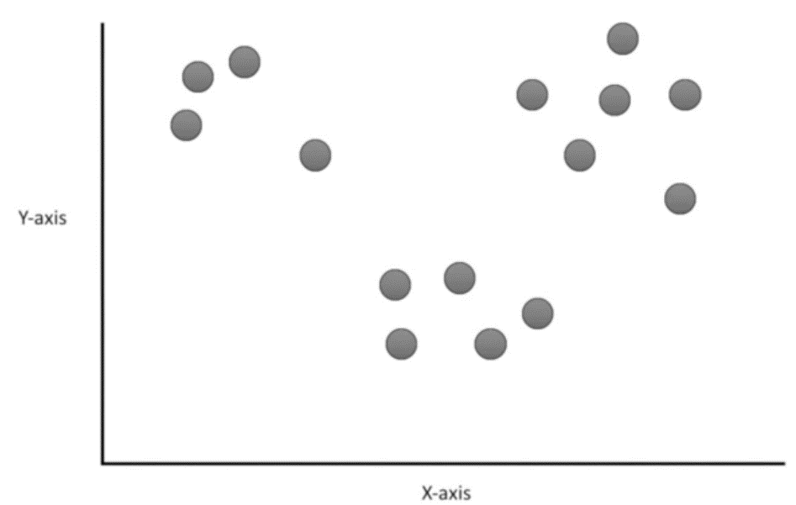
Start with 15 objects (data points) in a 2D feature space
See Video StatQuest: K-means Clustering https://youtu.be/4b5d3muPQmA

Slide 11
Place 3 random cluster points in feature space
See Video StatQuest: K-means Clustering https://youtu.be/4b5d3muPQmA

Slide 12
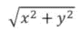
Assign each object to nearest cluster point using Euclidian distance
d =
d
y
x
See Video StatQuest: K-means Clustering https://youtu.be/4b5d3muPQmA

Slide 13
Assign each object to nearest cluster point using Euclidian distance
See Video StatQuest: K-means Clustering https://youtu.be/4b5d3muPQmA

Slide 14
Calculate the center of each cluster ...
See Video StatQuest: K-means Clustering https://youtu.be/4b5d3muPQmA

Slide 15
... and re-cluster
See Video StatQuest: K-means Clustering https://youtu.be/4b5d3muPQmA

Slide 16
Recalculate the center of each cluster ...
See Video StatQuest: K-means Clustering https://youtu.be/4b5d3muPQmA

Slide 17
... and recluster.
See Video StatQuest: K-means Clustering https://youtu.be/4b5d3muPQmA

Slide 18
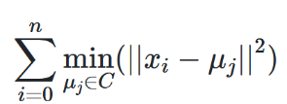
K-means Algorithm: Find a Centroid with Minimum Inertia (within-cluster sum of squares)
See Video StatQuest: K-means Clustering https://youtu.be/4b5d3muPQmA

Slide 19
Elbow Plot: Inertia as a function of number of clusters
Elbow in curve.
Huge reduction in inertia with K=3.
After that, small reductions.
Inertia
1 2 3 4 5 6
K clusters

Slide 20
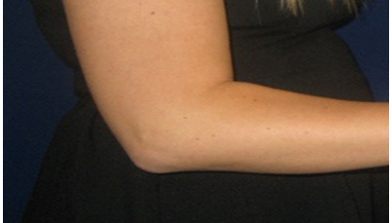
Finding the Elbow: Method #1
Examine by eye
Inertia
K clusters

Slide 21
Finding the Elbow: Method #2
Draw a line between the ends points of the elbow curve.
Measure the distance between each point and the line.
Point with the minimum distance is the elbow location
Inertia
K clusters

Slide 22
Finding the Elbow: Method #3
Find the slope of the line at each point.
Select the point that has a slope closest to 45 degrees.
Inertia
~45 deg slope
K clusters

Slide 23
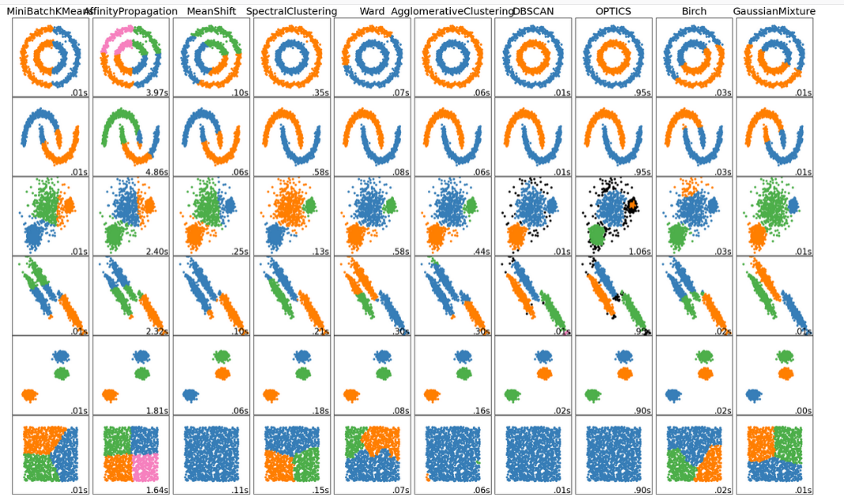
Clustering Algorithms in Scikit-Learn
B
A

Slide 24
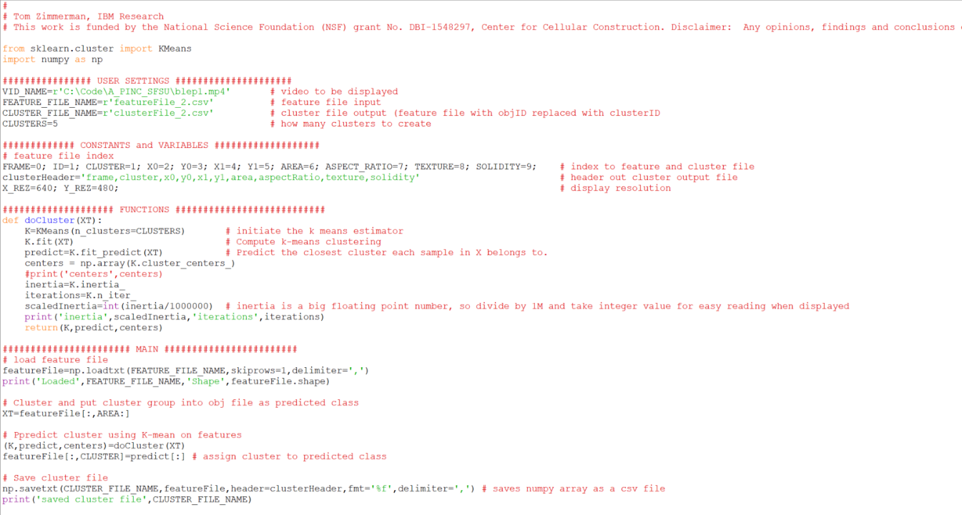
1
2
3
4
5
6
7
8
9
10
11
12
13
14
15
16
17
18
19
20
21
22
23
24
25
26
27
28
29
30
31
32
33
34
35
36
37
38
39
40
CLUSTERING CODE

Slide 25
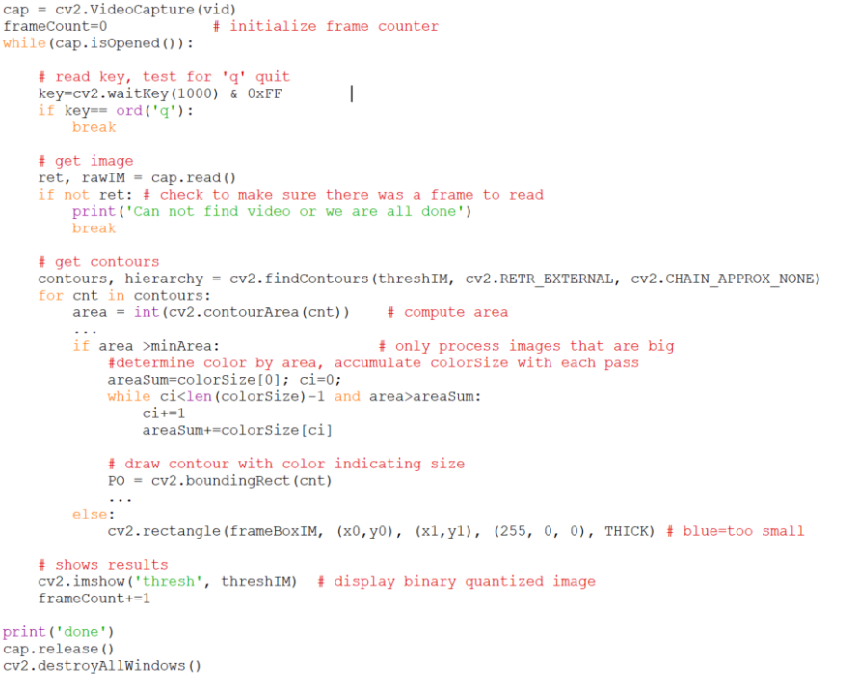
1
2
3
4
5
6
7
8
9
10
11
12
13
14
15
16
17
18
19
20
21
22
23
24
25
26
27
28
29
30
31
32
33
34
35
36
37
38
39
40
DETECT CODE

Slide 26
Sample of contourList from blep1.mp4
contourList, hierarchy = cv2.findContours(threshIM, cv2.RETR_EXTERNAL, cv2.CHAIN_APPROX_NONE)
Object (e.g. 150 per frame) Contour Points (e.g. 5 to 140 points per object)
typing in Shell
0 [[457 473]] [[457 474]] [[457 475]] [[458 474]] [[458 473]]
1 [[103 470]] [[102 471]] [[101 471]] [[100 471]] [[101 472]] [[101 473]] [[102 474]] [[102 475]] [[103 474]] [[104 473]]
2 [[447 462]] [[446 463]] [[445 463]] [[445 464]] [[444 465]] [[443 466]] [[442 466]] [[441 466]] [[440 466]] [[439 466]]
3 [[221 459]] [[221 460]] [[221 461]] [[222 462]] [[223 462]] [[224 461]] [[224 460]] [[223 459]] [[222 459]]
4 [[193 455]] [[192 456]] [[191 457]] [[190 458]] [[190 459]] [[190 460]]
5 [[538 452]] [[537 453]] [[536 453]] [[535 454]] [[534 455]] [[533 456]] [[533 457]] [[533 458]] [[532 459]] [[532 460]]
6 [[134 452]] [[133 453]] [[132 454]] [[132 455]] [[132 456]] [[133 457]] [[134 458]] [[135 458]]
7 [[474 451]] [[474 452]] [[473 453]] [[473 454]] [[474 455]] [[475 456]] [[476 455]]
8 [[294 448]] [[293 449]] [[293 450]] [[293 451]] [[293 452]] [[293 453]] [[294 454]] [[295 454]] [[296 454]] [[297 453]]
9 [[456 472]] [[455 473]] [[456 474]] [[457 474]] [[457 473]] [[457 472]]
10 [[100 471]] [[101 472]] [[102 473]] [[103 473]] [[104 473]] [[104 472]] [[103 471]] [[102 471]] [[101 471]]
11 [[446 462]] [[445 463]] [[444 464]] [[444 465]] [[443 466]] [[442 467]] [[441 467]] [[440 468]] [[439 468]] [[438 468]]
12 [[462 461]] [[461 462]] [[460 462]] [[459 463]] [[458 463]] [[457 463]] [[457 464]] [[457 465]] [[458 466]] [[459 467]]
13 [[222 458]] [[221 459]] [[220 460]] [[220 461]] [[221 462]] [[221 463]] [[222 463]] [[223 463]]
14 [[476 454]] [[475 455]] [[474 456]] [[474 457]] [[475 458]] [[476 459]] [[477 459]] [[478 459]] [[478 458]] [[479 457]]
15 [[191 454]] [[190 455]] [[190 456]] [[189 457]] [[189 458]] [[189 459]] [[190 460]]
16 [[132 452]] [[131 453]] [[132 454]] [[132 455]] [[133 456]] [[134 456]] [[135 456]] [[135 455]] [[135 454]]
17 [[536 451]] [[535 452]] [[534 452]] [[533 453]] [[532 454]] [[532 455]] [[531 456]] [[531 457]] [[531 458]] [[531 459]]
>>> type(contourList)
<class 'list'>
>>> type(contourList[0])
<class 'numpy.ndarray'>
>>> contourList[0].shape
(7, 1, 2)
>>> contourList[0]
array([[[457, 472]],
[[456, 473]],
[[456, 474]],
[[456, 475]],
[[457, 475]],
[[457, 474]],
[[457, 473]]], dtype=int32)

Slide 27
1
2
3
4
5
6
7
8
9
10
11
12
13
14
15
16
17
18
19
20
21
22
23
24
25
26
27
28
29
30
31
32
33
34
35
36
37
38
39
40
DETECT CODE
Frame
Object
Color

Slide 28
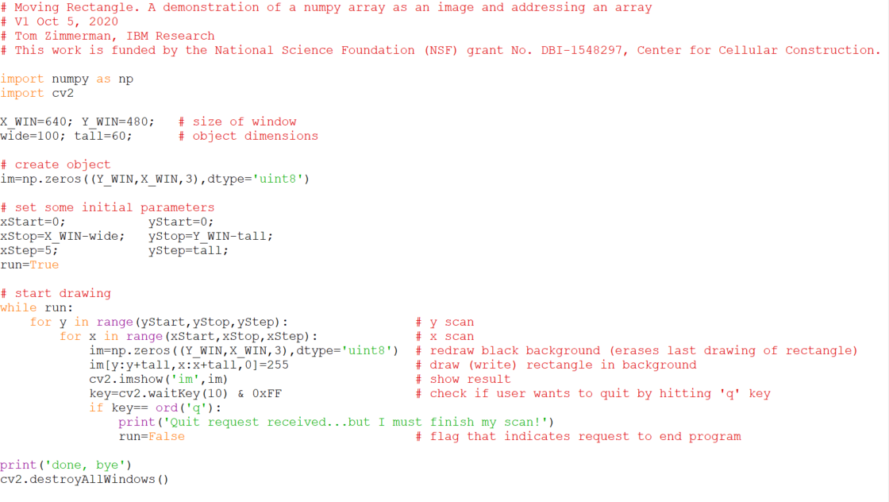
1
2
3
4
5
6
7
8
9
10
11
12
13
14
15
16
17
18
19
20
21
22
23
24
25
26
27
28
29
30
31
32
33
34
35
36
MOVING RECTANGLE CODE

Slide 29
1
2
3
4
5
6
7
8
9
10
11
12
13
14
15
16
17
18
19
20
21
22
23
24
25
26
27
28
29
30
31
32
33
34
35
36
MOVING RECTANGLE CODE
Scan entire window
Scan horizonal (X)
Scan vertical (Y)

Slide 30
Reference Material
Loops
https://www.w3schools.com/python/python_for_loops.asp
https://wiki.python.org/moin/ForLoop
Conditionals
https://openbookproject.net/thinkcs/python/english3e/conditionals.html

Slide 31
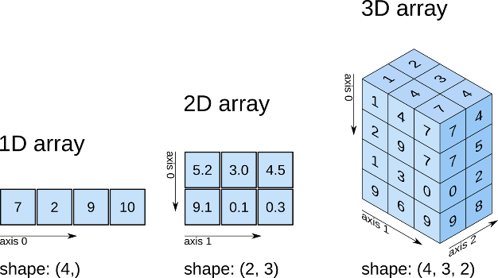
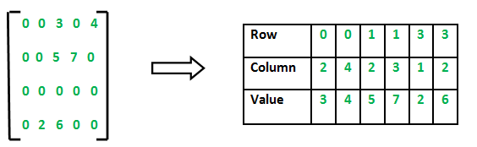
Visualizing Numpy Arrays
See Tutorial Video: https://youtu.be/ktyW-kOqGpY
https://www.oreilly.com/library/view/elegant-scipy/9781491922927/assets/elsp_0105.png
https://media.geeksforgeeks.org/wp-content/uploads/Sparse-Matrix-Array-Representation1.png

Slide 32
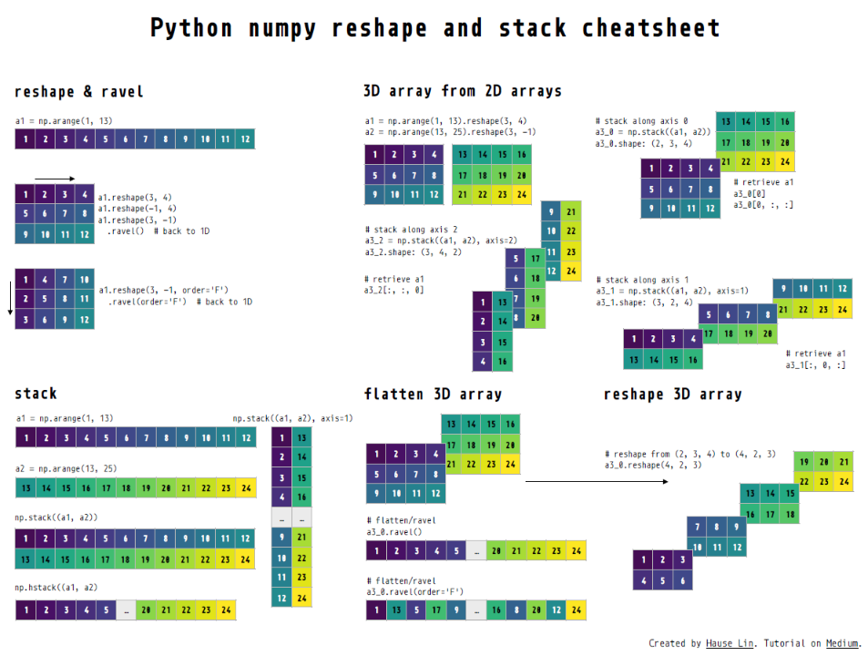
https://github.com/hauselin/rtutorialsite/blob/master/_posts/2019-12-20-numpy-reshape/reshape.pdf

Slide 33
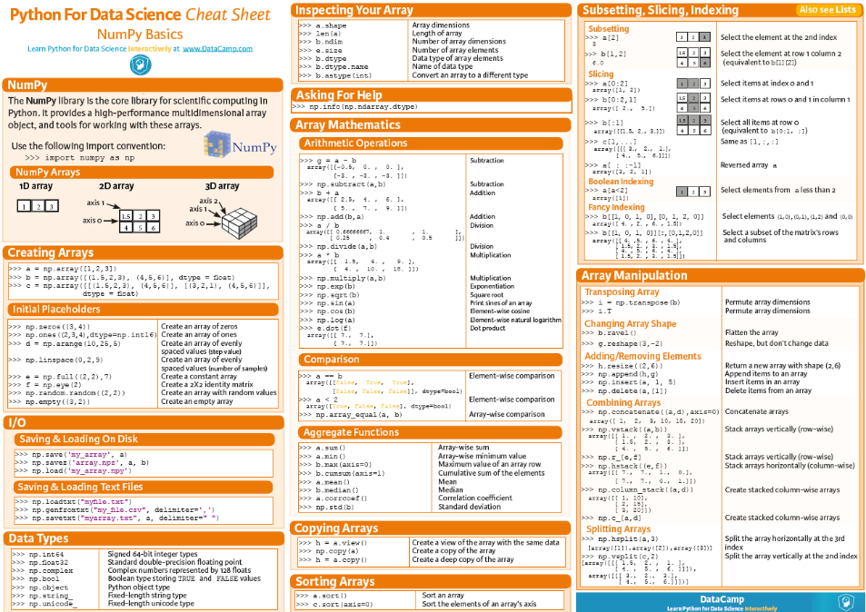
http://community.datacamp.com.s3.amazonaws.com/community/production/ckeditor_assets/pictures/329/content_content_button-cheatsheet-numpy.png

Slide 34
Modulo operation(%) finds the remainder after the division of one number by another (called the modulus of the operation). Handy way to make sure a variable never exceeds a value and instead wraps around starting from zero.
7%3=1 # 7/3=2 remainder 1
0%3=0
1%3=1
2%3=2
3%3=0
4%3=1
5%3=2
6%3=0
7%3=1
8%3=2
9%3=0
10%3=1
11%3=2

Slide 35
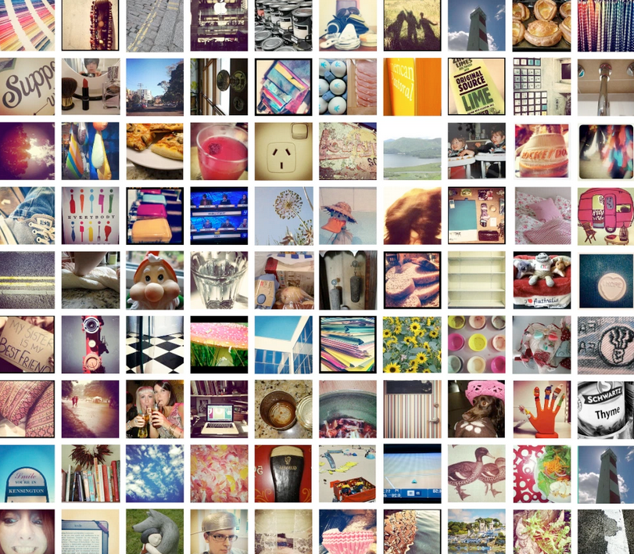
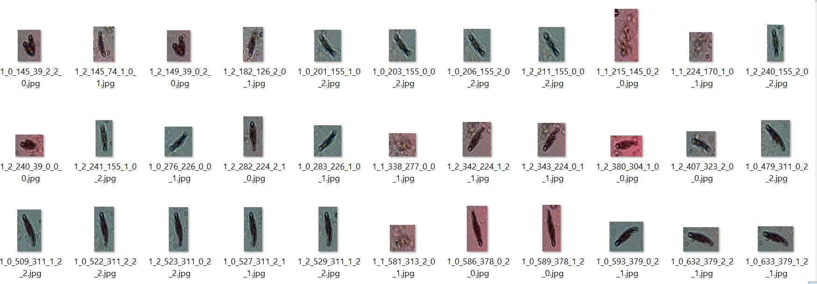
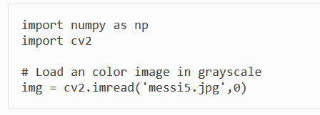
Viewing Images with Windows Explorer vs. Grid of Images
https://rebeccaliggins.wordpress.com/tag/grid/
Step1. Search “python image open cv2”
Found: https://opencv-python-tutroals.readthedocs.io/en/latest/py_tutorials/py_gui/py_image_display/py_image_display.html

Slide 36
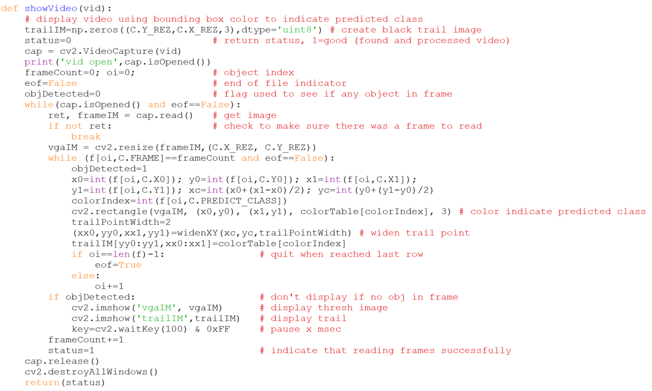
1
2
3
4
5
6
7
8
9
10
11
12
13
14
15
16
17
18
19
20
21
22
23
24
25
26
27
28
29
30
31
32

Slide 37
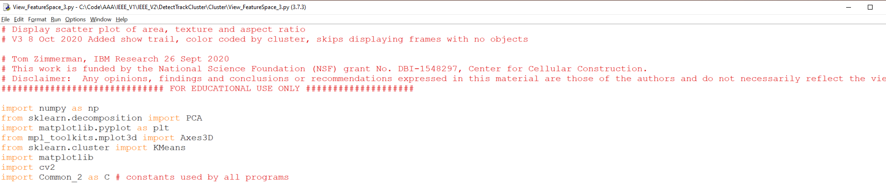
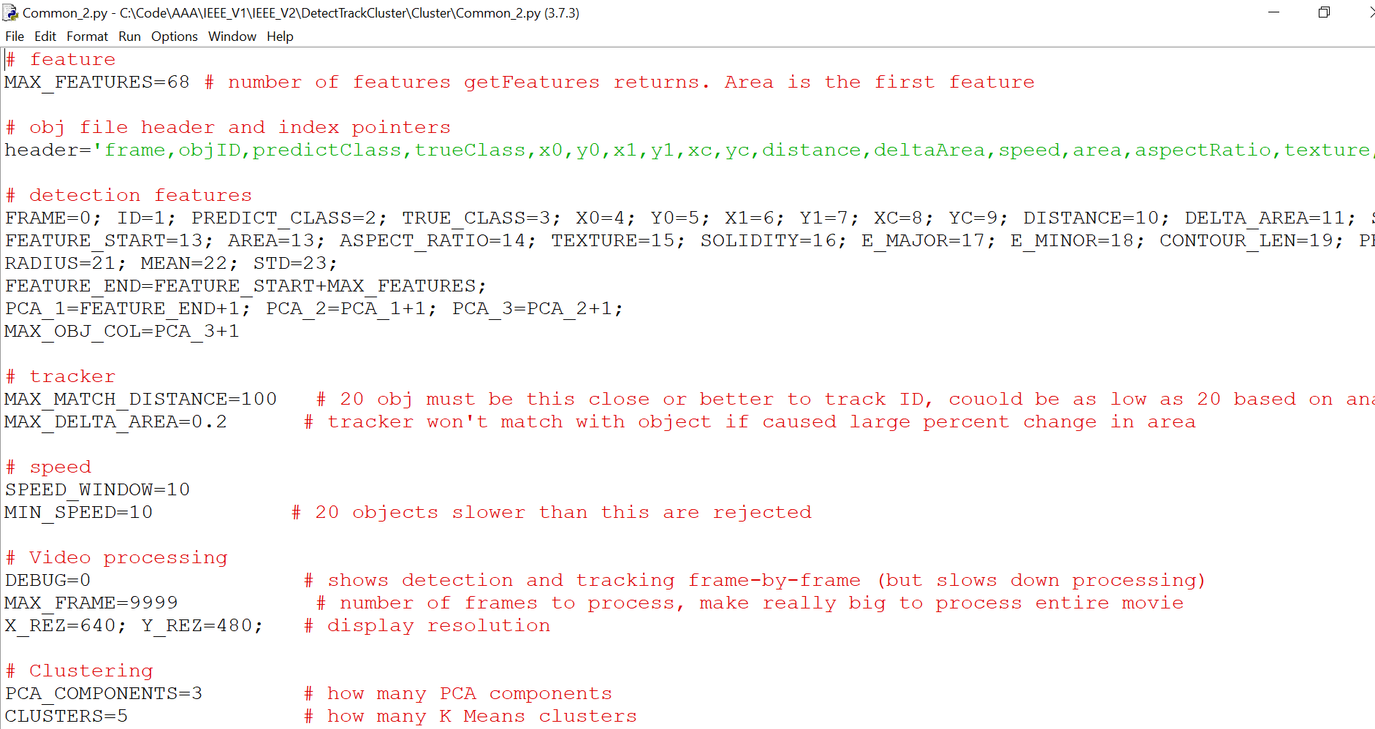
1
2
3
4
5
6
7
8
9
10
11
12
13
14
15
16
17
1
2
3
4
5
6
7
8
9
10
11
12
13
14
15
16
17
18
19
20
21
22
23
24
25
26
27
28

Slide 38
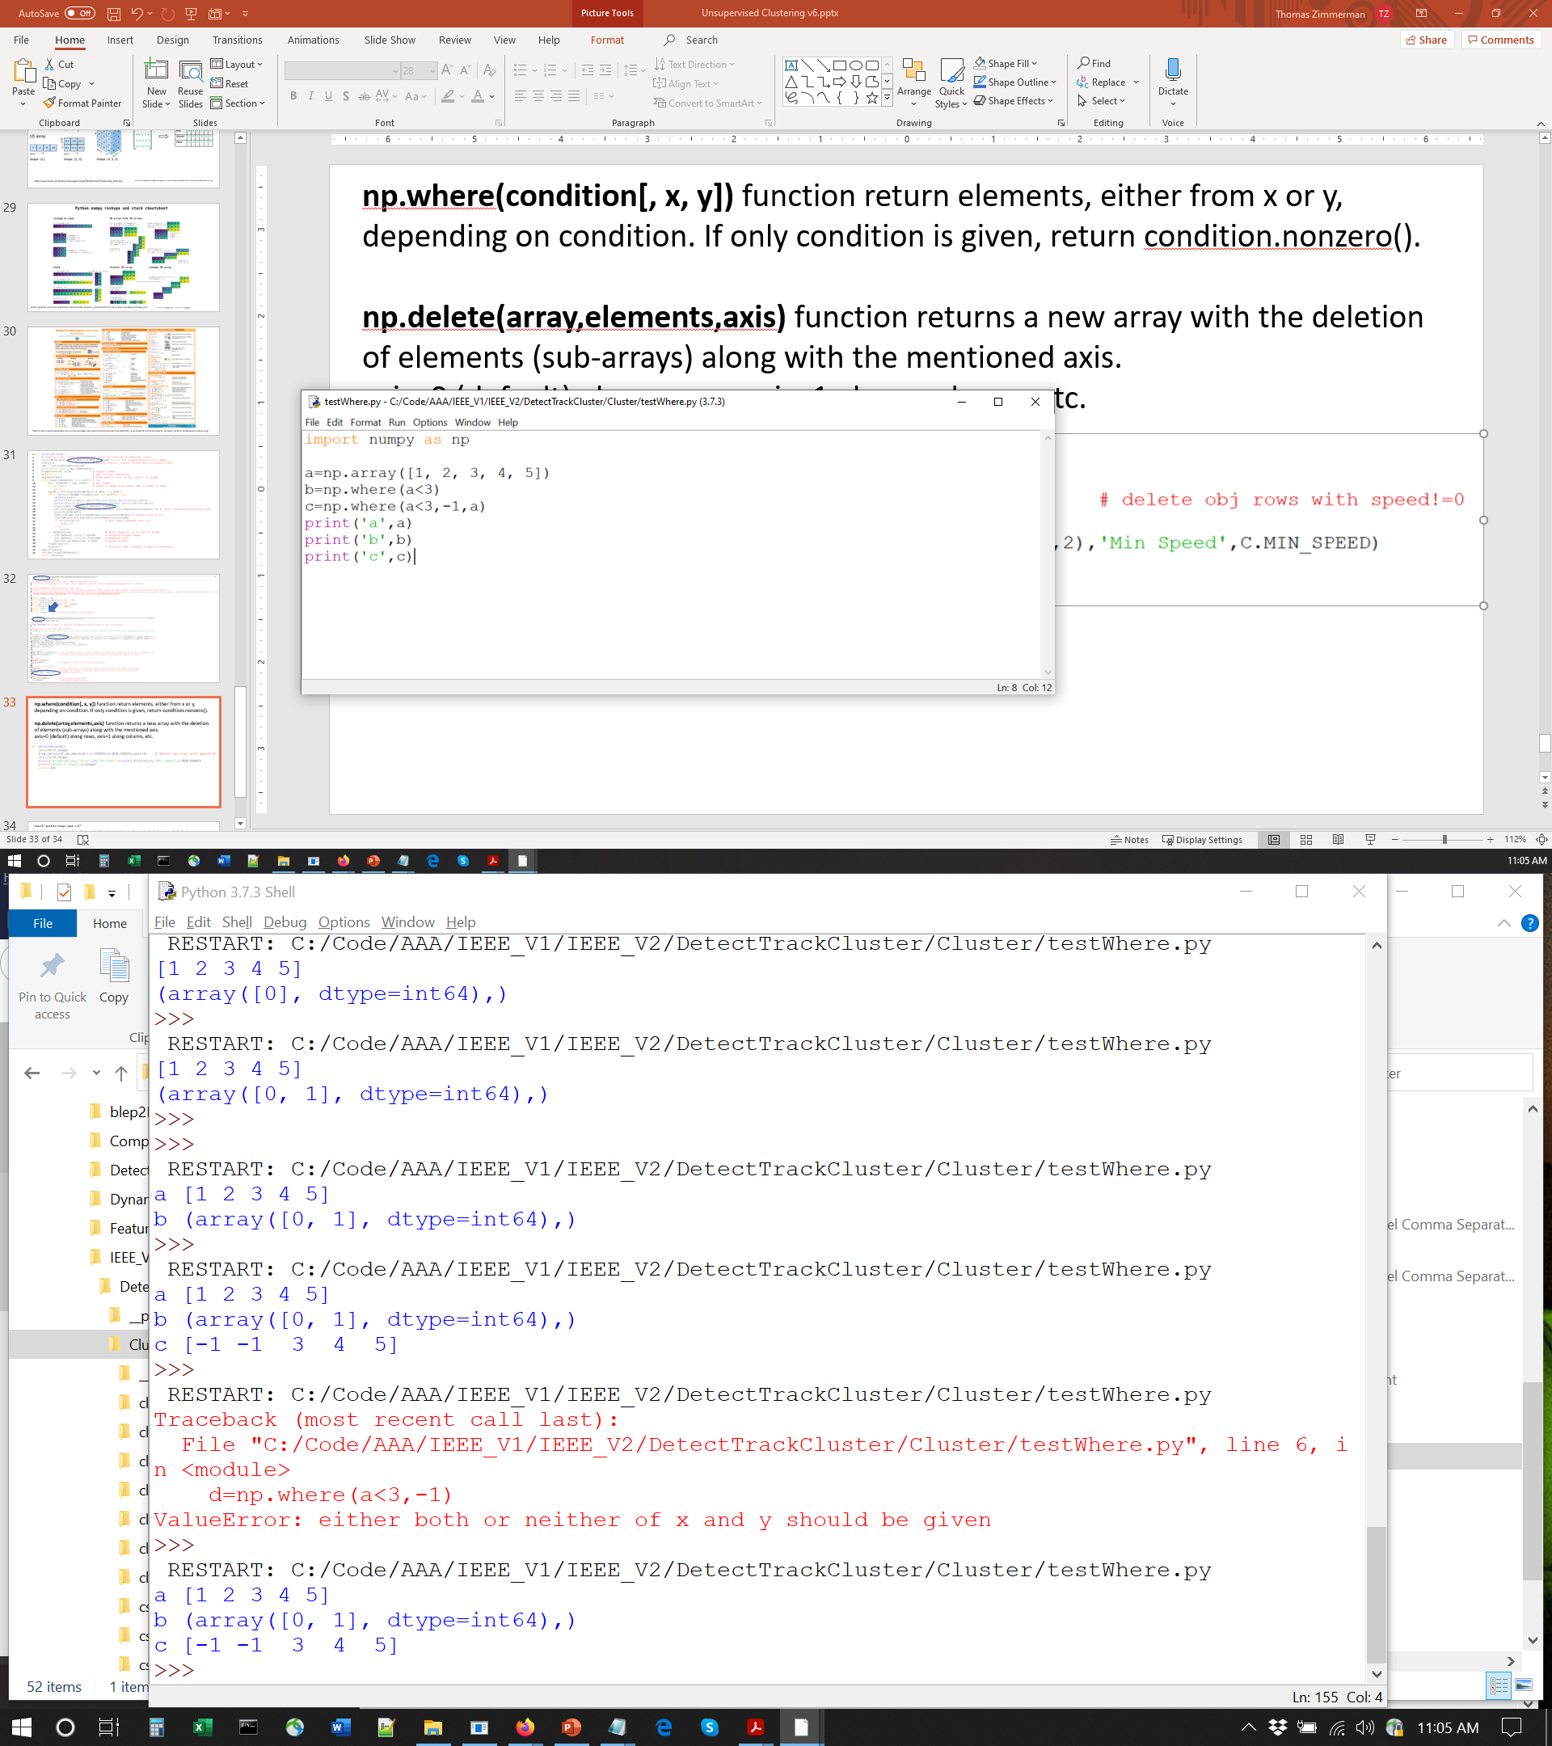
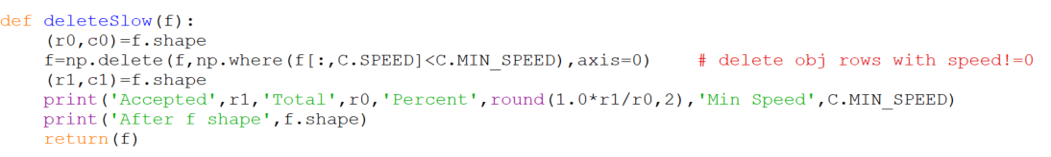
np.where(condition[, x, y]) function return elements, either from x or y, depending on condition. If only condition is given, return condition.nonzero().
np.delete(array,elements,axis) function returns a new array with the deletion of elements (sub-arrays) along with the mentioned axis, where axis=0 (default) along rows, axis=1 along column, etc.

